Slide 1
AZURE
ASWATHY C S
213393@ust-global.com

Slide 2
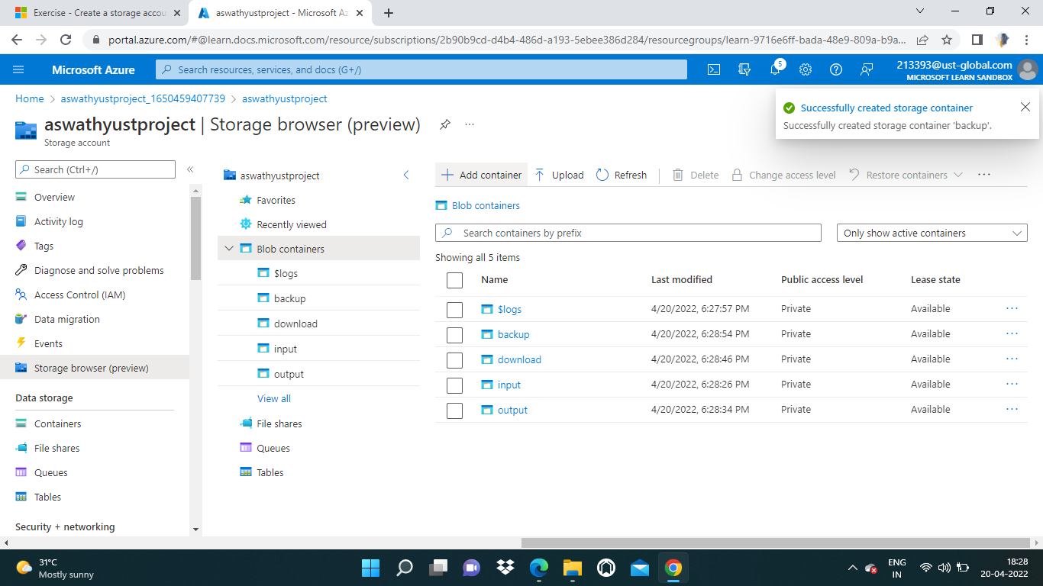
STORAGE ACCOUNT IN AZURE

Slide 3
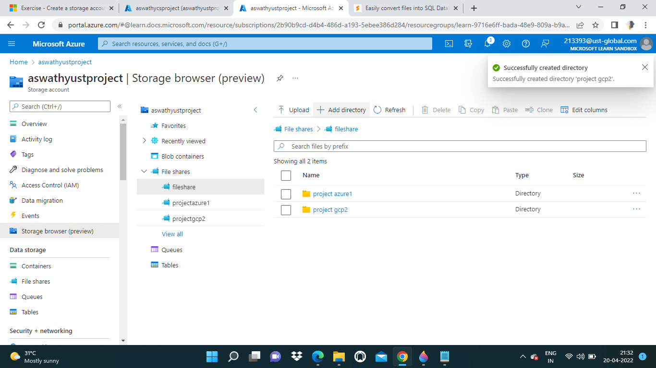
FILE SHARE

Slide 4
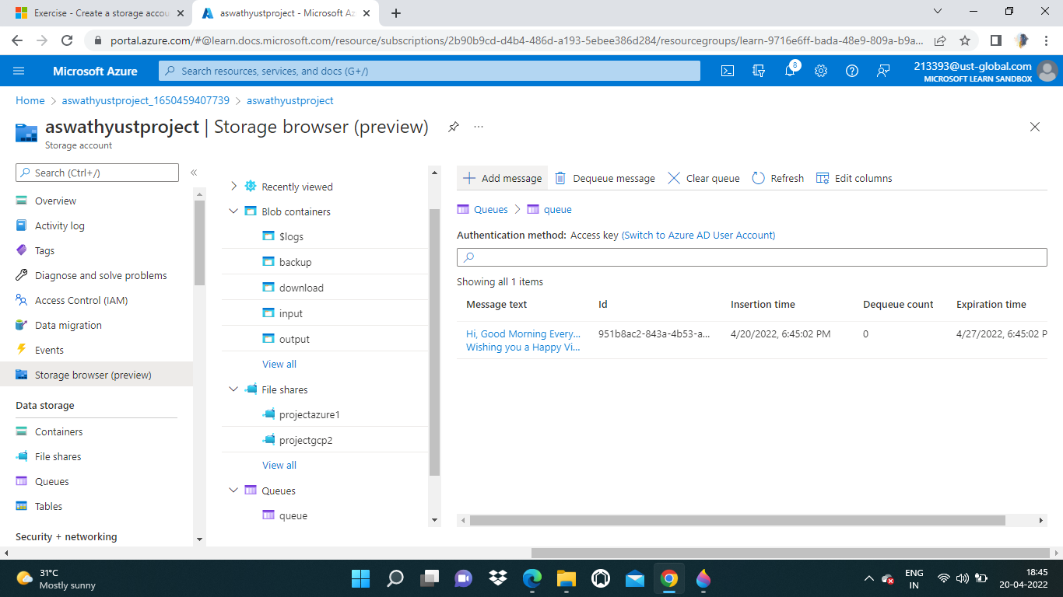
QUEUE MESSAGE

Slide 5
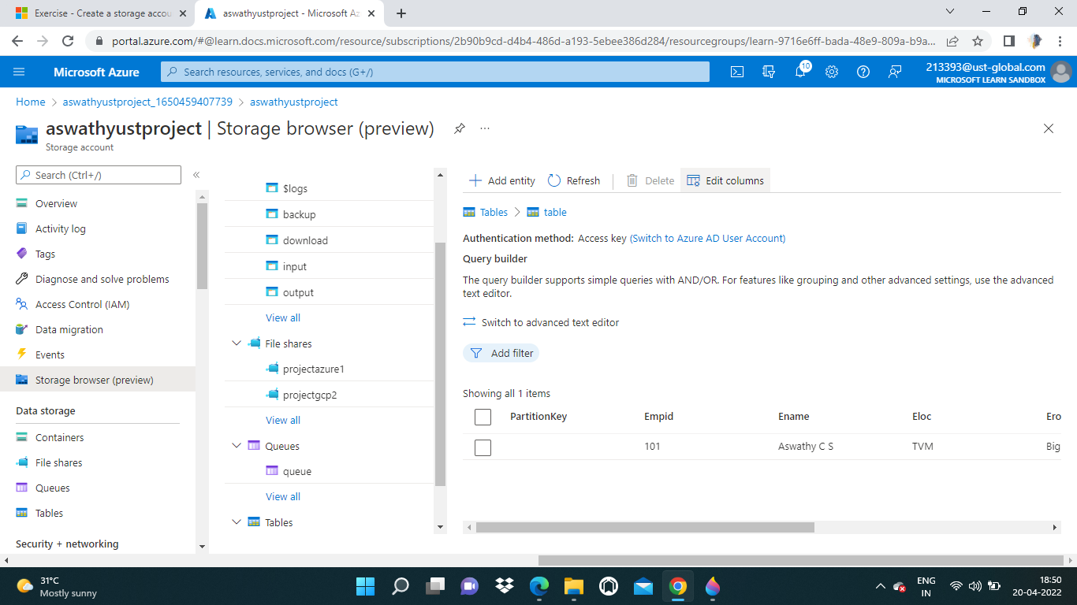
TABLE

Slide 6
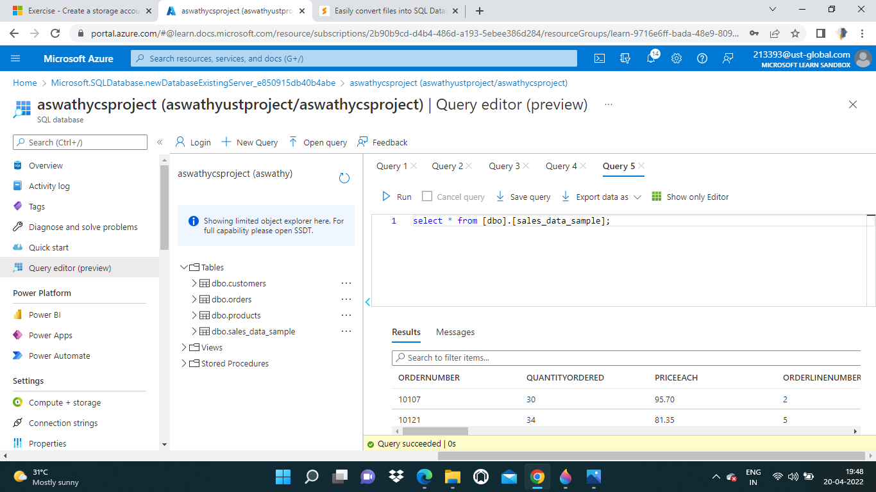
SAMPLE DATABASE WITH A QUERY

Slide 7
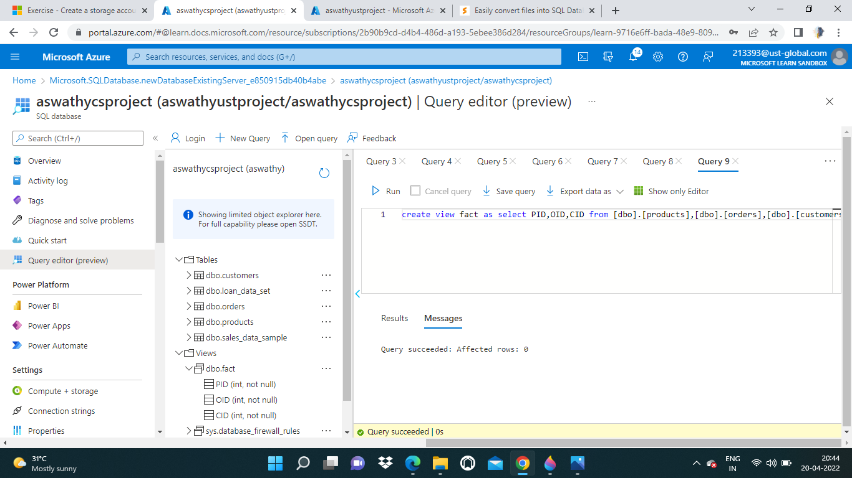
To estimate the unit sales of retail goods

Slide 8
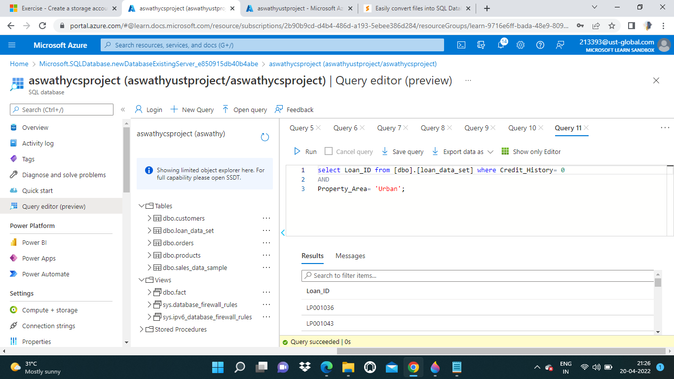
Financial Need Programs for Consumer Loan Products

